Slide 1
Secure Data hiding in images using steganography
CAPSTONE PROJECT
Presented By: Pendela Sri Harshini Lalitha
Student Name : Pendela Sri Harshini Lalitha
College Name & Department : PBR Visvodaya institute of technology and science & computer science and engineering

Slide 2
OUTLINE
Problem Statement
Technology used
Wow factor
End users
Result
Conclusion
Git-hub Link
Future scope

Slide 3
Problem Statement
With the growing need for secure communication, traditional encryption methods are often not enough to conceal the existence of sensitive data. Steganography offers a powerful solution by embedding secret information within digital images in a way that is imperceptible to human vision. This project aims to develop a secure and efficient steganographic system for hiding data inside images while maintaining their visual integrity and security.
With increased cyber threats, ensuring secure data transmission is crucial.Conventional encryption makes data unreadable but does not hide its existence.
To securely embed confidential data inside images.To maintain image quality after data embedding.To retrieve hidden data accurately without distortion.
With the rise of digital communication, protecting sensitive data from unauthorized access and cyber threats is crucial. While traditional encryption methods ensure data confidentiality, they fail to conceal the data's existence. Steganography helps embed secret information within images, making it undetectable. However, conventional steganographic techniques lack transparency and security against tampering. This project proposes a novel approach by integrating blockchain technology with image steganography to enhance data security, immutability, and verifiability.

Slide 4
Technology used
Libraries and Platforms Used in Secure Data Hiding Using Steganography
1.Libraries
Used OpenCV (cv2):
Used for reading, modifying, and saving images.
OS Module (os)
Used for file operations like reading, writing, and opening images.
Helps in managing encrypted images securely.
2.Platforms
Python (Interpreter & Development Platform)
Primary language for implementing the steganography algorithm.
Supports cross-platform execution (Windows, Linux, macOS).
Jupyter Notebook / PyCharm / VS Code (IDE)
Used for coding, testing, and debugging the steganography system.
Provides better visualization and debugging tools.
Windows / Linux / macOS (Operating System)
The project can run on any OS that supports Python and OpenCV.
Image encryption and decryption work on all platforms.

Slide 5
Wow factors
Invisible Data Embedding:
Hides secret information within images without noticeable visual changes.
Password-Protected Decryption:
Only users with the correct passcode can extract the hidden data, ensuring controlled access and enhanced security.
Efficient Pixel Manipulation:
Uses optimized algorithms to store data within specific pixel channels (RGB) while maintaining image quality.
Support for Various Image Formats:
The system can work with multiple image formats like PNG and JPEG, ensuring flexibility in use.
Customizable Message Length:
Allows hiding of variable-length messages depending on the image size, making it adaptable for different security needs.

Slide 6
End users
This project can be used by various individuals and organizations that require covert communication and secure data storage. The key end users include:
Government and Intelligence Agencies
Journalists and Whistleblowers
Military and Defense Organizations
Corporate Sector & Cybersecurity Professionals
Forensic Investigators & Law Enforcement
General Public & Privacy Enthusiasts

Slide 7
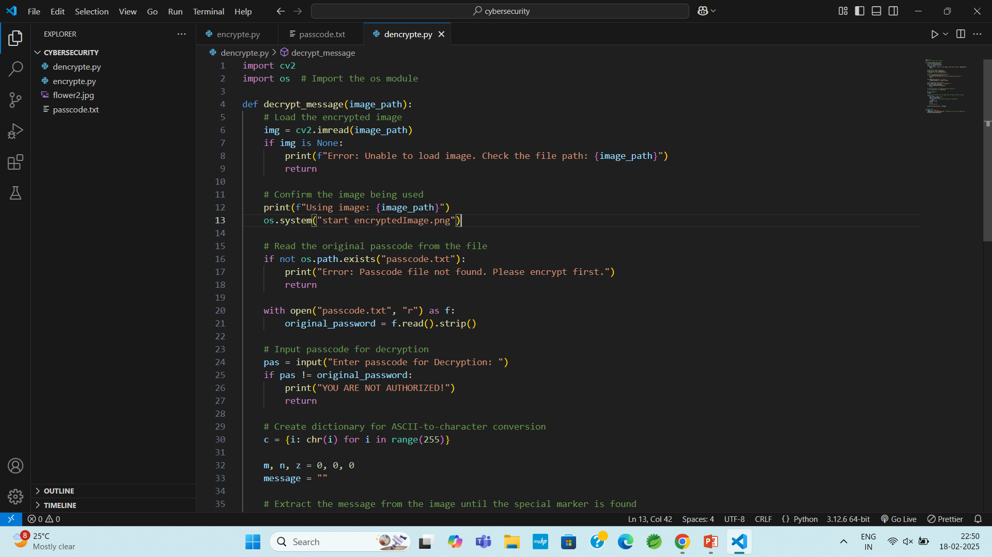
Results

Slide 8
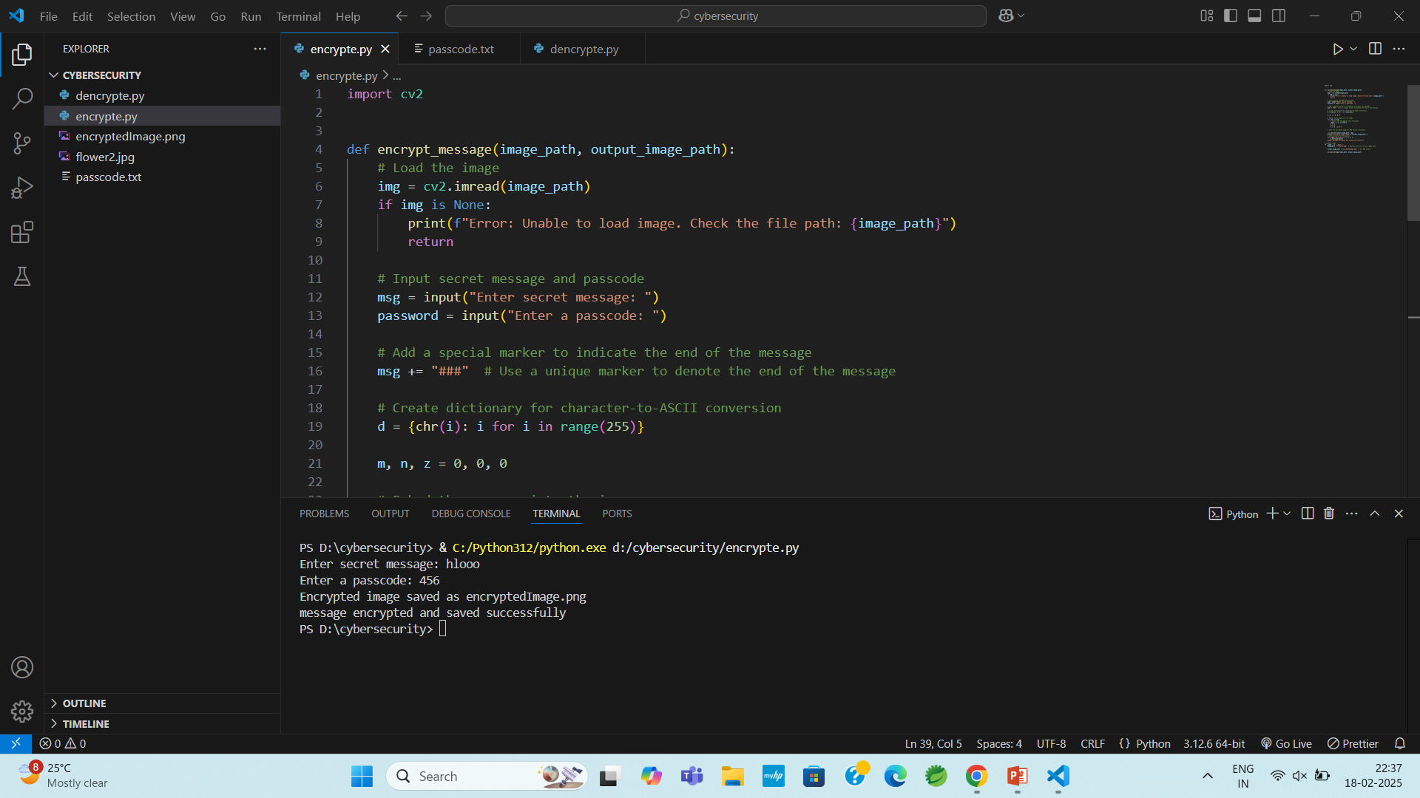

Slide 9
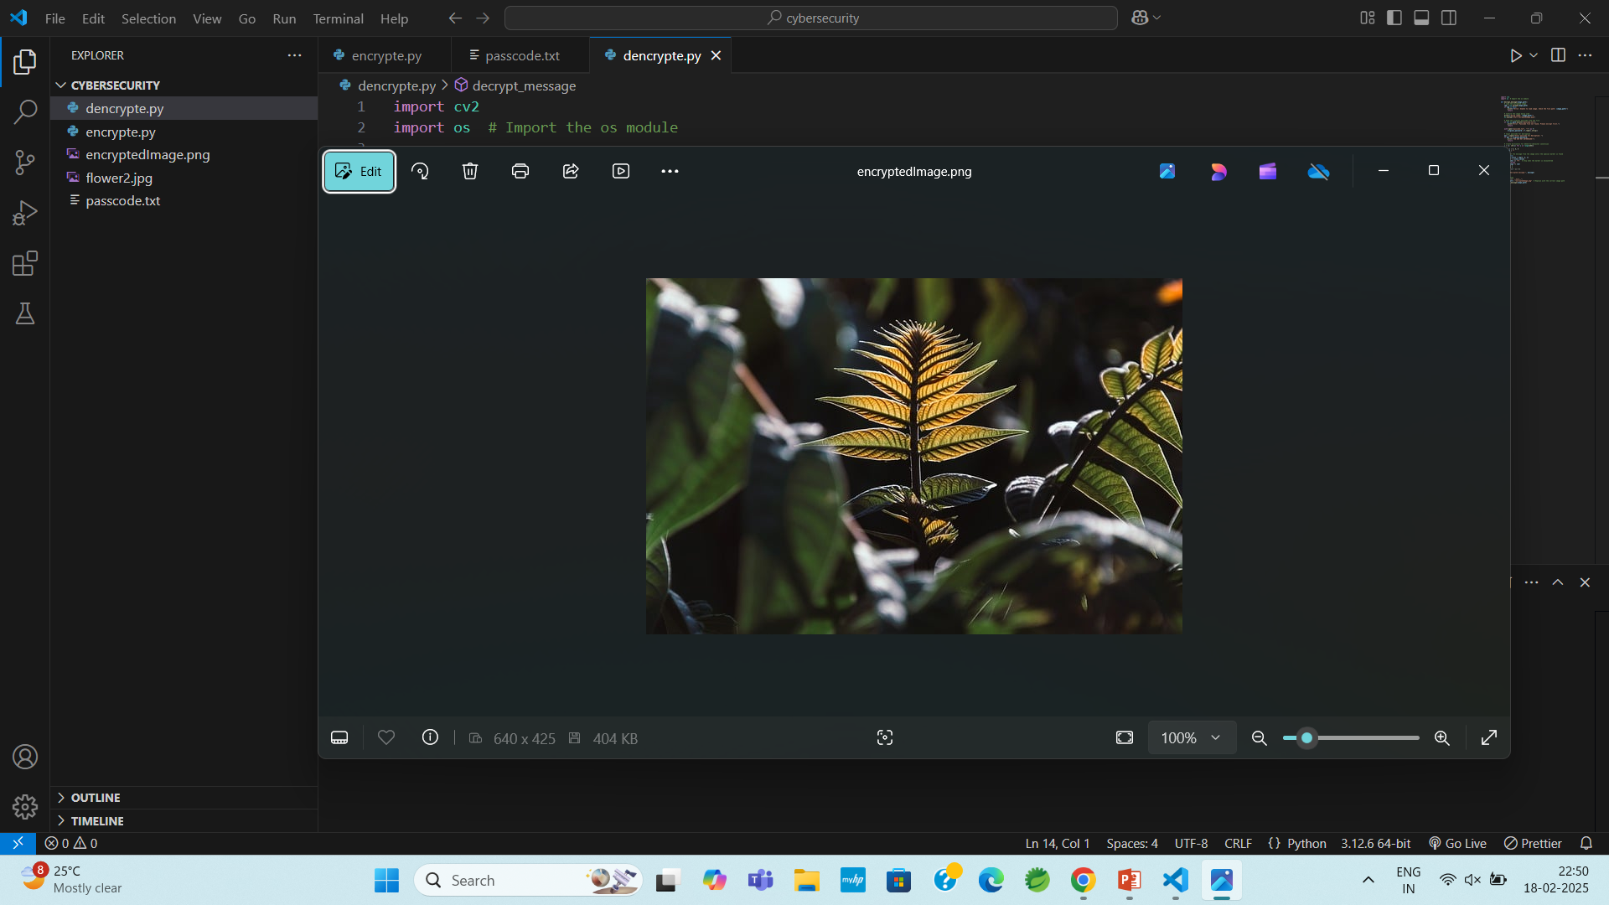

Slide 10
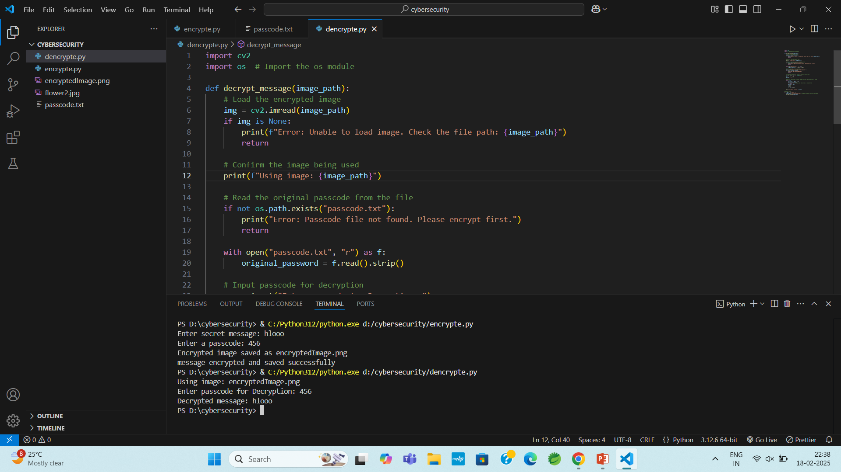

Slide 11
Conclusion
Secure data hiding in images using steganography provides a powerful method for confidential communication by embedding secret information within digital images without altering their visual appearance. Unlike traditional encryption, which only secures data but does not conceal its existence, steganography ensures that sensitive information remains undetectable to unauthorized users. By utilizing techniques such as Least Significant Bit (LSB) substitution and cryptographic encryption, this approach enhances security, prevents steganalysis attacks, and ensures lossless data recovery. The proposed system offers high imperceptibility, robustness, and adaptability, making it suitable for applications in military communications, secure messaging, copyright protection, and digital forensics. Despite its advantages, steganography has limitations, such as vulnerability to image compression and steganalysis techniques, which can be addressed through advanced adaptive steganography methods and AI-powered security enhancements. Overall, this project demonstrates an effective and practical approach to secure data transmission, ensuring confidentiality and integrity in digital communications while minimizing the risk of detection.

Slide 12
GitHub Link
http://github.com/harshini200212/steganography.git

Slide 13
Future scope(optional)
AI-driven adaptive steganography: will enhance security by making hidden data undetectable to advanced steganalysis tools.
Blockchain integration: will ensure data integrity and prevent tampering by storing cryptographic hashes of hidden information.
Quantum cryptography: could revolutionize steganographic security by leveraging quantum-safe encryption methods.
Improved robustness: against image compression and transformations will allow secure data hiding in various media formats, including videos and 3D images.
Integration with IoT and cloud computing: will enable secure, covert data transmission in smart devices and cloud-based storage systems.

Slide 14
THANK YOU

